Slide 1


SEMINAR ON GEOFENCE
SUBMITTED BY :-
SAHIL MATHUR(15ECTCS083)
AJAY SHARMA
ABHINAV CHOUHAN
SUBMITTED TO :-
PROFESSOR DEVENDRA TIWARI

Slide 2
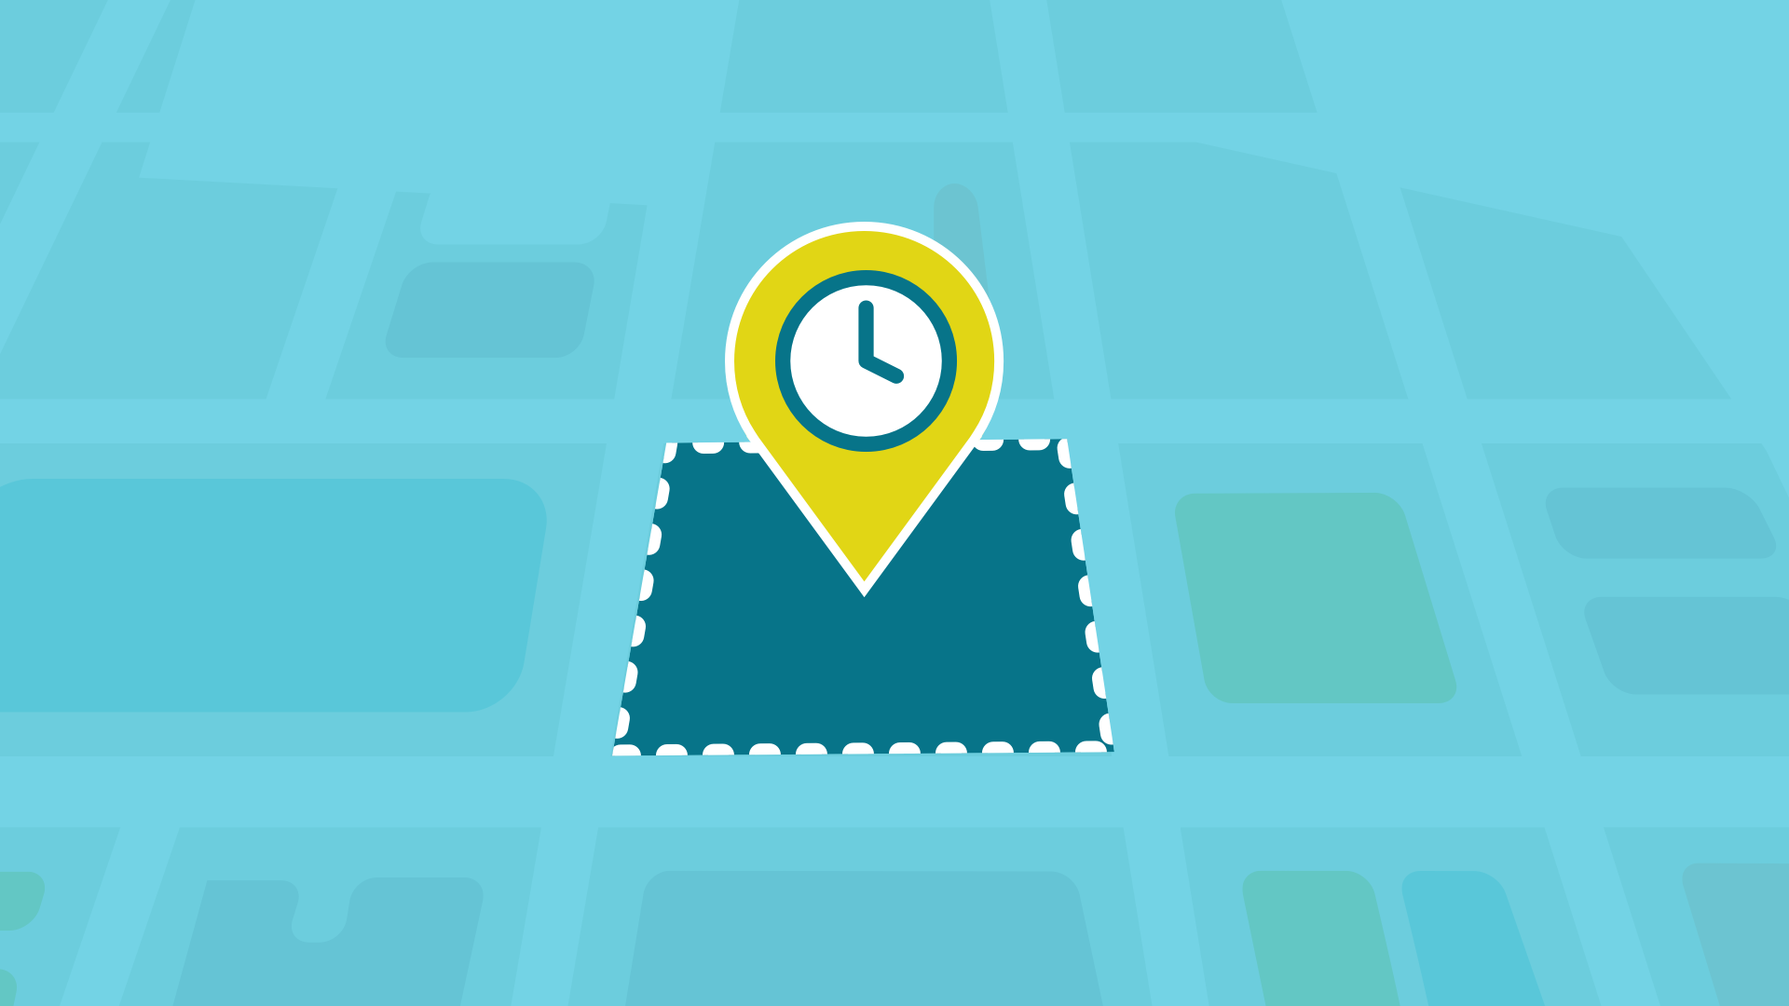
“Create a virtual geographic boundary around (an area) by means of GPS or RFID technology,
enabling software to trigger a response when a mobile device enters or leaves the area.”
Geofence

Slide 3





INTERNSHIP ORGANIZATION
ESTB.
1988
CDAC
(CENTRE FOR DEVELOPMENT
OF ADVANCE COMPUTING)
PARAM 8000
i.e the first
supercomputer
Widely spread
across many cities
Research in diversified field

Slide 4
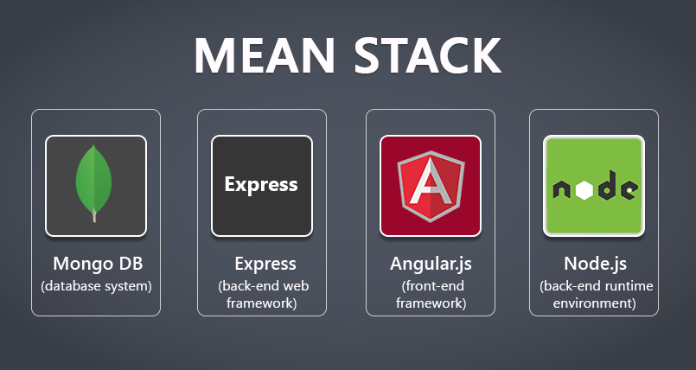

Slide 5

TECHNOLOGIES
USED

Slide 6


“IT ALLOWS USER TO JUMP TO OTHER LOCATION BY PROVIDING LINK”

Slide 7

“DESCRIBES THE STYLE OF HTML”

Slide 8
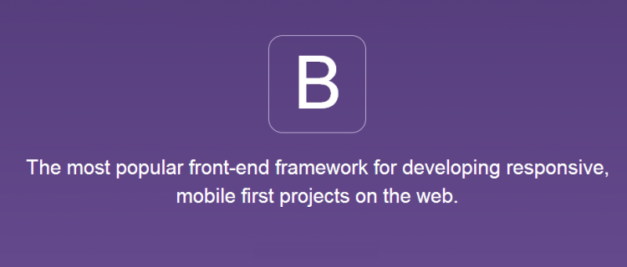

Slide 9
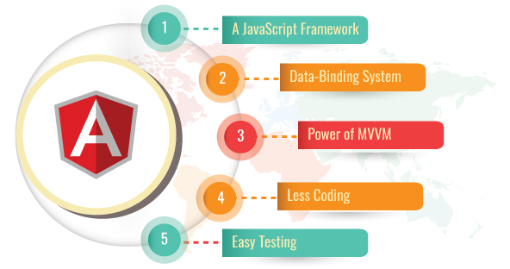

Slide 10


Slide 11

Built on google chromes v8 engine
Single-threaded
Server side platform
Allows you to run javascript on the server.

Slide 12
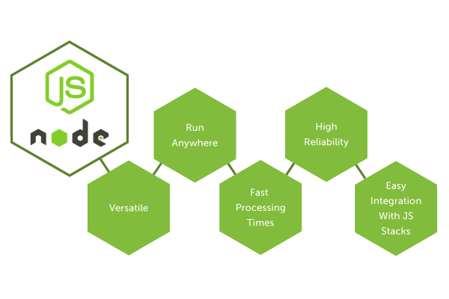

Slide 13


Slide 14

Node js web application server framework
Sets up middleware to
respond to HTTP request
Dynamically render HTML pages
RESTFUL API

Slide 15


Slide 16
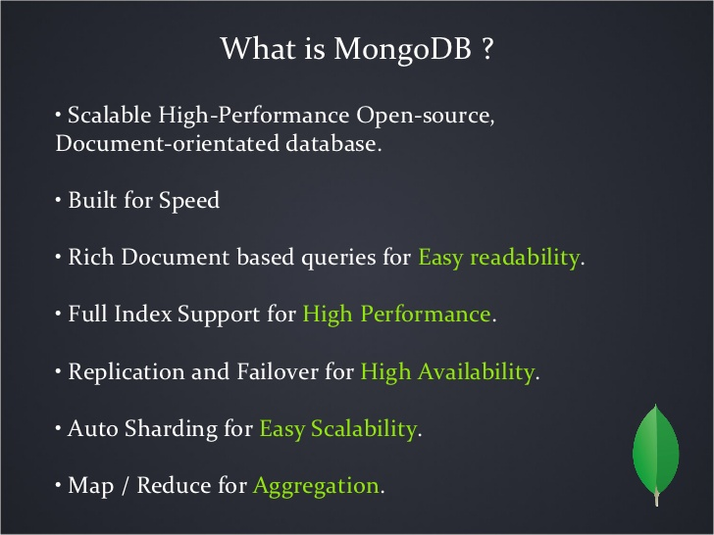

Slide 17
GEOX

Slide 18
What is GEOX?
“GEOX is basically an automated attendance system that is being created to ease the paperwork and
maintain a attendance database of the student in institutes. We are using geofence as the main pillar to fix this problem and a database mongoDB for storing students information.”

Slide 19
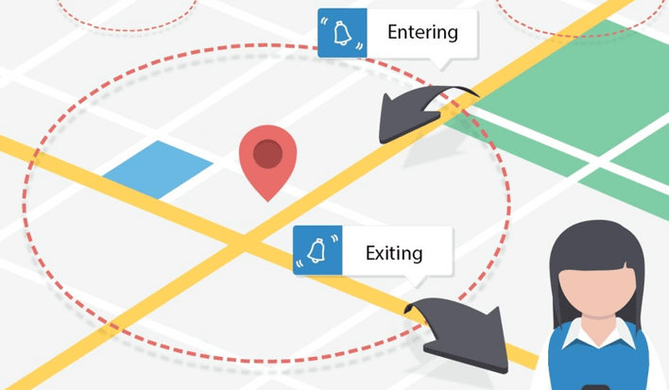
What is GEOFENCING?
“A geofence is a virtual fence or a perimeter around a physical location.
Geofencing is a tool to connect the virtual experience with the offline
world’s physical location.”
When an object enters this area, something happens.
Easy way to think about it a fence around your home.
When someone enters your yard, the burglar alarm is activated.

Slide 20
Creating a Virtual parameter
Define the area
Obtain its lattitude and longitude
Create a rectangle or circle or polygon
Use gmaps API
VIRTUAL PARAMETER IS CREATED

Slide 21

Sends a
push notification
as the
user enters
the geofence!

Slide 22

GEOX PROVIDES COMPREHENSIVE UI

Slide 23




MANUAL CREATION OF DATABASE
PROBLEMS
FACED
Time consuming
LOTS OF PAPERWORK

Slide 24
Automated attendance system
Time saving
Easy user interface
Accuracy
Improved operational effeciency
Problems
Overcome

Slide 25
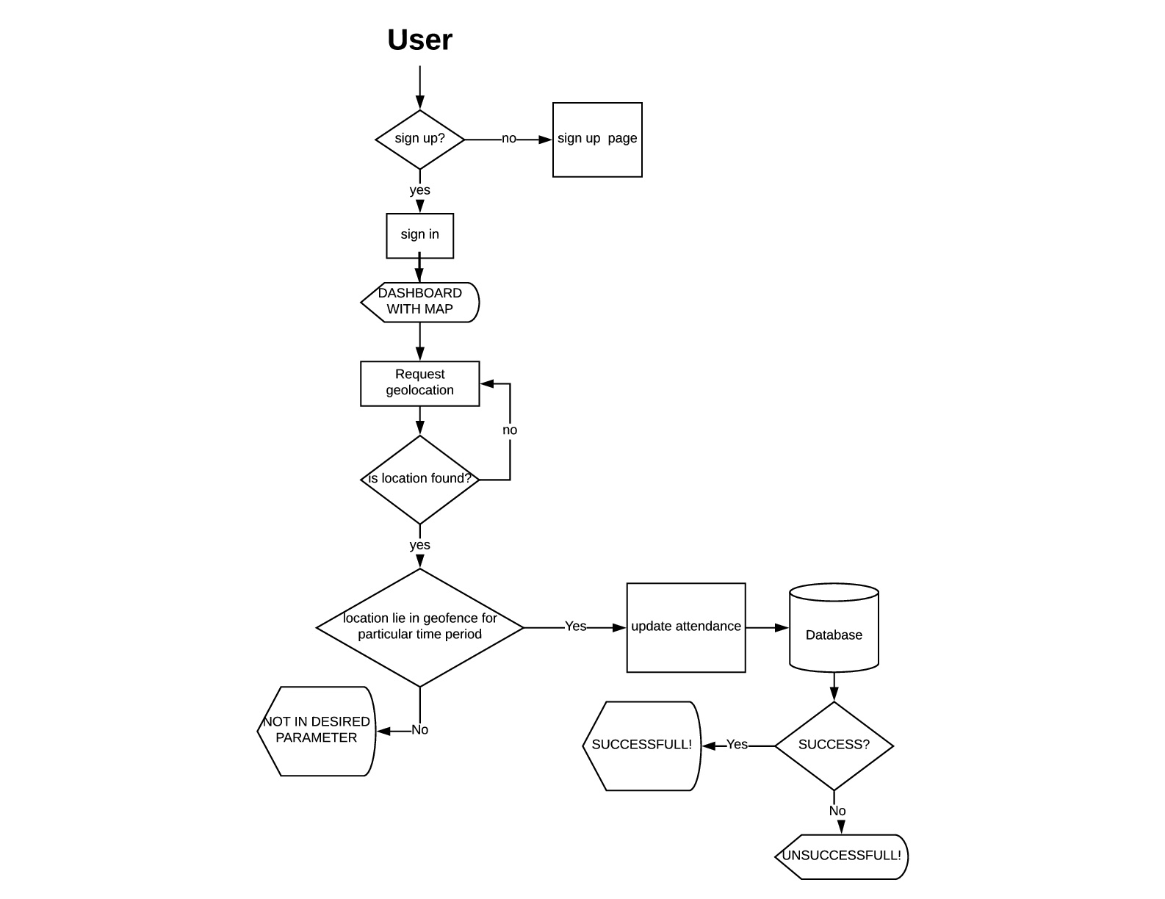

Flowchart for
User

Slide 26
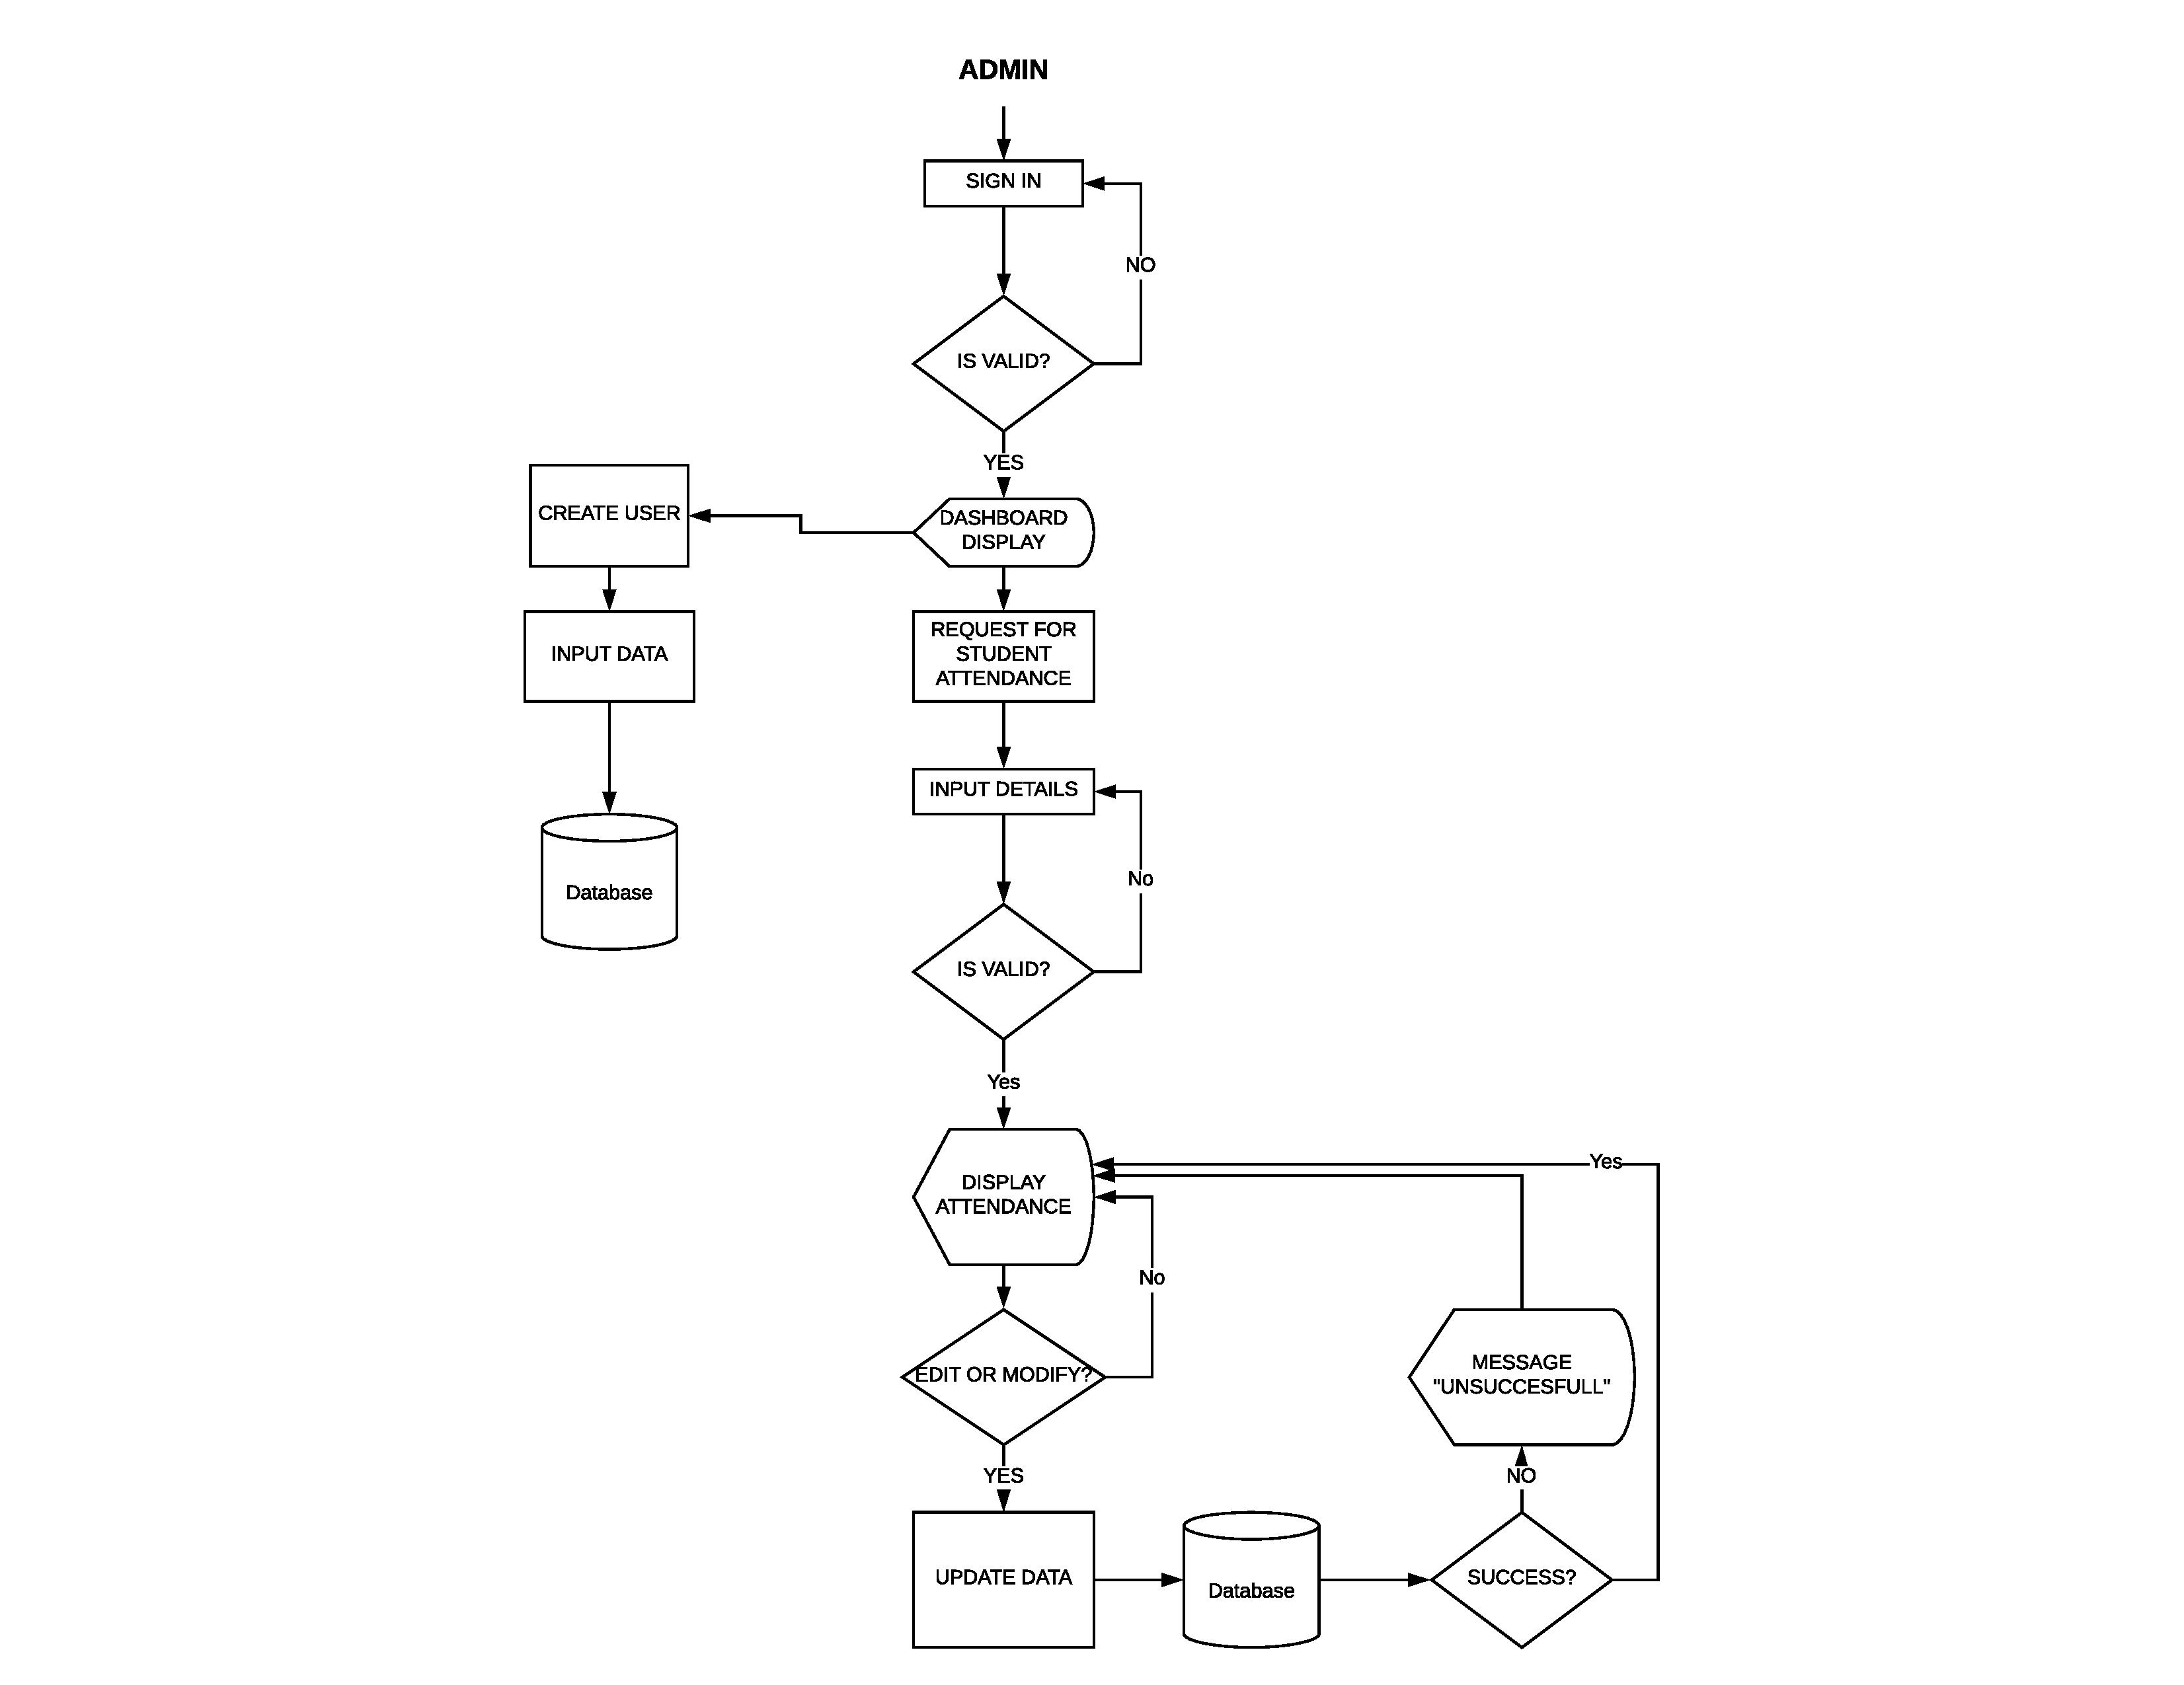

Flowchart for
Admin

Slide 27

Screenshots of the GEOX

Slide 28
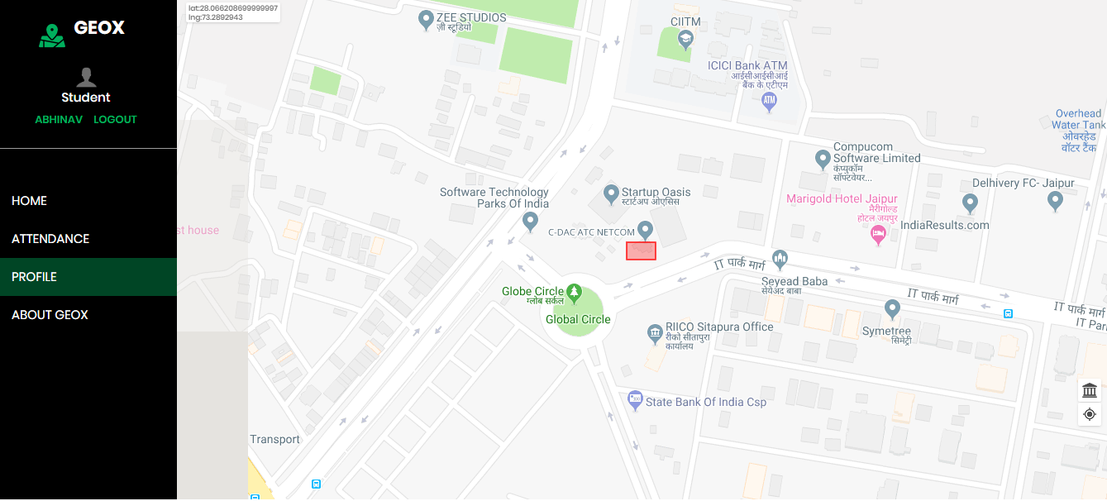
Dash
board

Slide 29
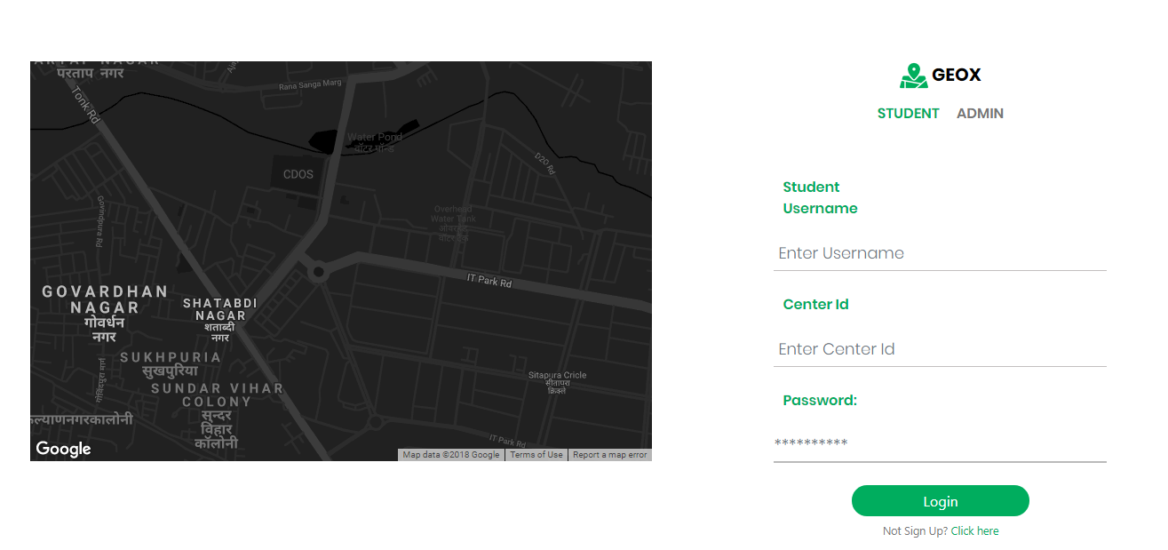
login

Slide 30
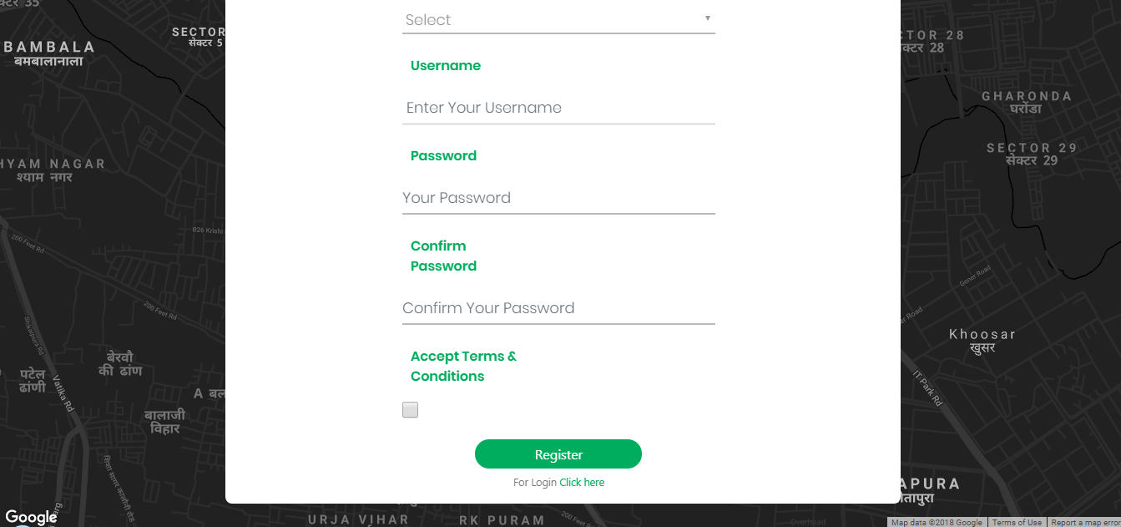
Signup

Slide 31
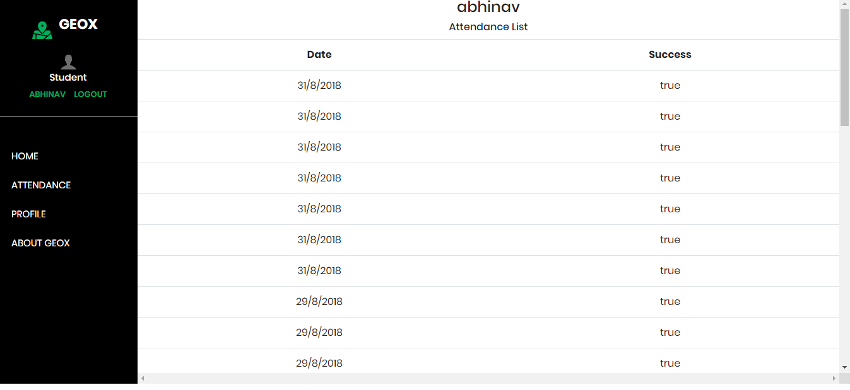
Attendance
list

Slide 32
